Slide 1

Today’s Program
Services Locations
New Patient Welcome Video
Performance—Quality Dashboard
Teeing up the Moves
Helping you with the transition
Campus Stars
Community Program Profile
FALL 2017
CEO
TOWN HALL
with Dr. Warren Browner, CEO
and Ameet Nanda, SA/VP
Notes:
PAC Ameet Nanda – SA/VP
An exciting year/lot going on
Getting closer to 2020, and new hospitals are just around the corner
Key right now: communicating more with you re the transition/creating plans to ensure a smooth transition-for you and our patients.

Slide 2
Today’s Program
Services Locations
New Patient Welcome Video
Performance—Quality Dashboard
Teeing up the Moves
Helping you with the transition
Campus Stars
Community Program Profile
FALL 2017
CEO
TOWN HALL
with Dr. Warren Browner, CEO
and Diane Petruzzella, VP of Surgical Services
Notes:
CAL Diane Petruzzella – VP of Surgical Services
An exciting year/lot going on
Getting closer to 2020, and new hospitals are just around the corner
Key right now: communicating more with you re the transition/creating plans to ensure a smooth transition-for you and our patients.

Slide 3
Today’s Program
Services Locations
New Patient Welcome Video
Performance—Quality Dashboard
Teeing up the Moves
Helping you with the transition
Campus Stars
Community Program Profile
FALL 2017
CEO
TOWN HALL
with Dr. Warren Browner, CEO
and Mary Lanier, CEO
Notes:
Davies Mary Lanier – CAO
An exciting year/lot going on
Getting closer to 2020, and new hospitals are just around the corner
Key right now: communicating more with you re the transition/creating plans to ensure a smooth transition-for you and our patients.

Slide 4
Today’s Program
Services Locations
New Patient Welcome Video
Performance—Quality Dashboard
Teeing up the Moves
Helping you with the transition
Campus Stars
Community Program Profile
FALL 2017
CEO
TOWN HALL
with Dr. Warren Browner, CEO
and Shannon Thomas, Director of Nursing
Notes:
STL Shannon Thomas – Director of Nursing
An exciting year/lot going on
Getting closer to 2020, and new hospitals are just around the corner
Key right now: communicating more with you re the transition/creating plans to ensure a smooth transition-for you and our patients.
PAC Ameet Nanda – SA/VP
CAL Diane Petruzzella – VP of Surgical Services
Davies Mary Lanier – CAO
STL Shannon Thomas – Director of Nursing

Slide 5
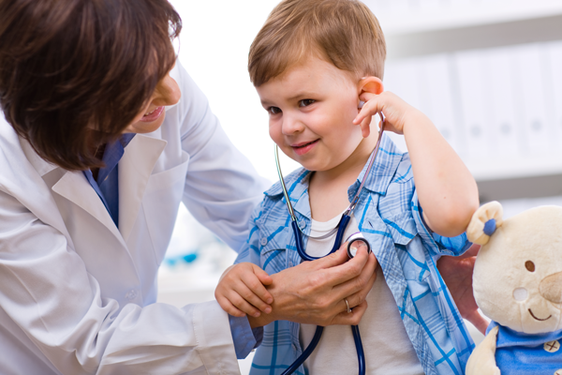

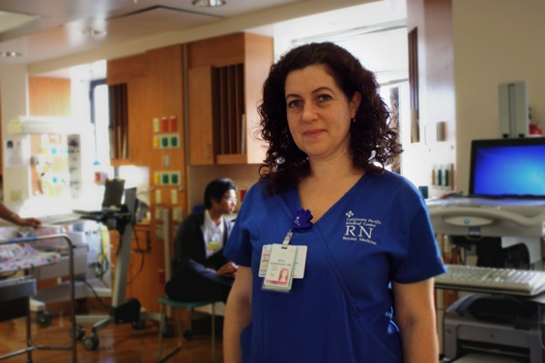

Our CPMC2020 Themes
erformance
are
C
P
e
M
C
ommunity
Notes:
Just a quick reminder re our CPMC2020 themes.
More than just bricks and mortar: 4 Themes moving forward
>>Need new photos

Slide 6
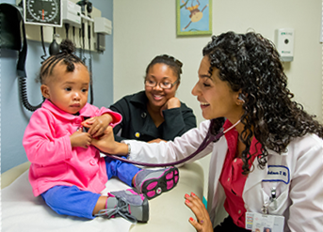
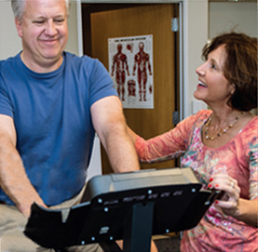
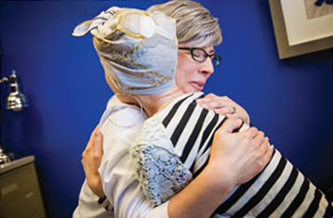
Care
Performance
Me
Community

Slide 7
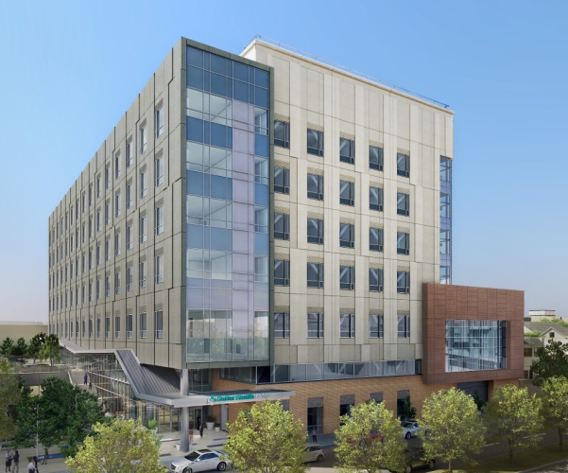
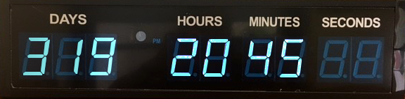
A look at Mission Bernal
Less than a year until we open!
Timeclock now on mySutter Intranet
Notes:
It’s getting very real—escalation of activity leading up to August 25 patient move
We’re One CPMC, and the transition to both new hospitals will touch all of us
(Plus some of you at Pac or Cal may be moving to Mission Bernal or vice-versa??)
(ST Lukes) – ??? Days to Aug 25th Opening.

Slide 8
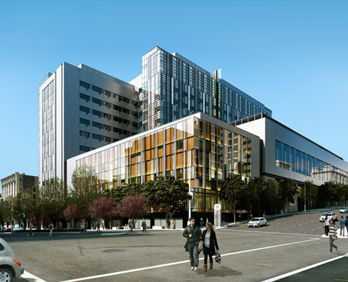
75% complete
Construction Complete: August 2018
Patient Occupancy: March 2019
85% Complete
Construction Complete: May 1, 2018
Patient Occupancy: Late August 2018
New World, A better one
Mission Bernal campus
Van Ness campus
Notes:
These are not just makeovers. It’s going to be a whole new world for CPMC with Mission Bernal and Van Ness.
[SLH: Remember when Cesar Chavez used to be called Army St? New name, new look – and no one talks about the old days any more.]
Pac?
Cal?
Davies?
-- Or remember what it was like before the EHR? Paper Charts, illegible handwriting?

Slide 9
Key Dates
Mission Bernal campus
May: Construction Completed
June—August: Staff Training/Stock new hospital
August: Celebrations
August 25th: Patient Move

Slide 10
Key Dates
Van Ness Campus
August 2018: Construction completed
September-October: Staff Training/Stock new hospital
Feb & March 2019: Celebrations
March 2nd & 3rd, 2019: Patient Move

Slide 11

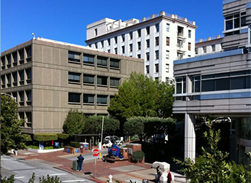
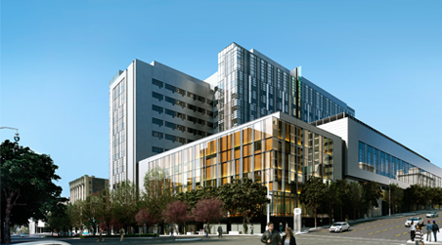

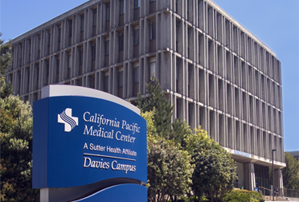
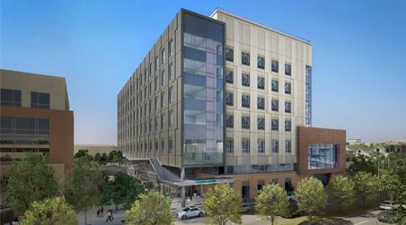
PACIFIC HEIGHTS Outpatient Only
CPMC2020: The Big Picture
Van Ness 274 Acute Beds
DAVIES 125 Acute & Rehab Beds
Mission bernal 120 Acute Beds
Notes:
Acknowledge that locations of services-where will I work?-has been a key question
We are XXX% there in finalizing locations
First, a quick reminder re the big picture

Slide 12
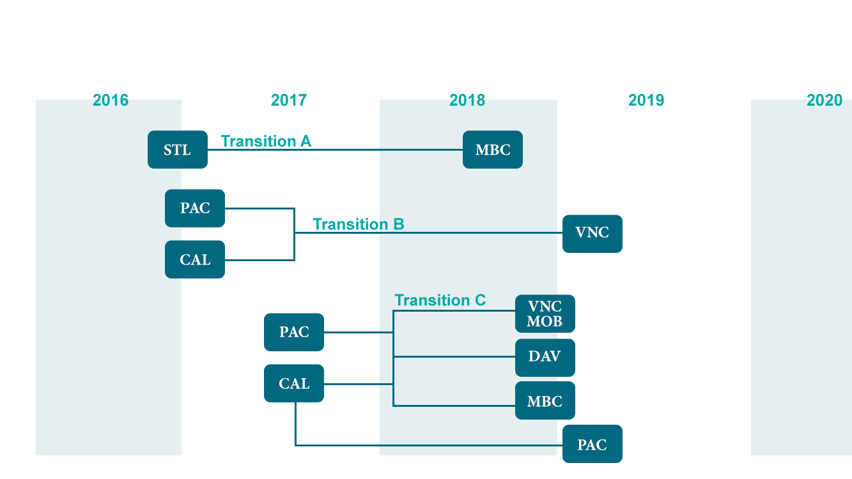
Transition Timeline
2017
2018
2019
2020
STL
MB
PAC
VN
CAL
VN MOB
PAC O/P
PAC
CAL O/P
MB
DAV

Slide 13
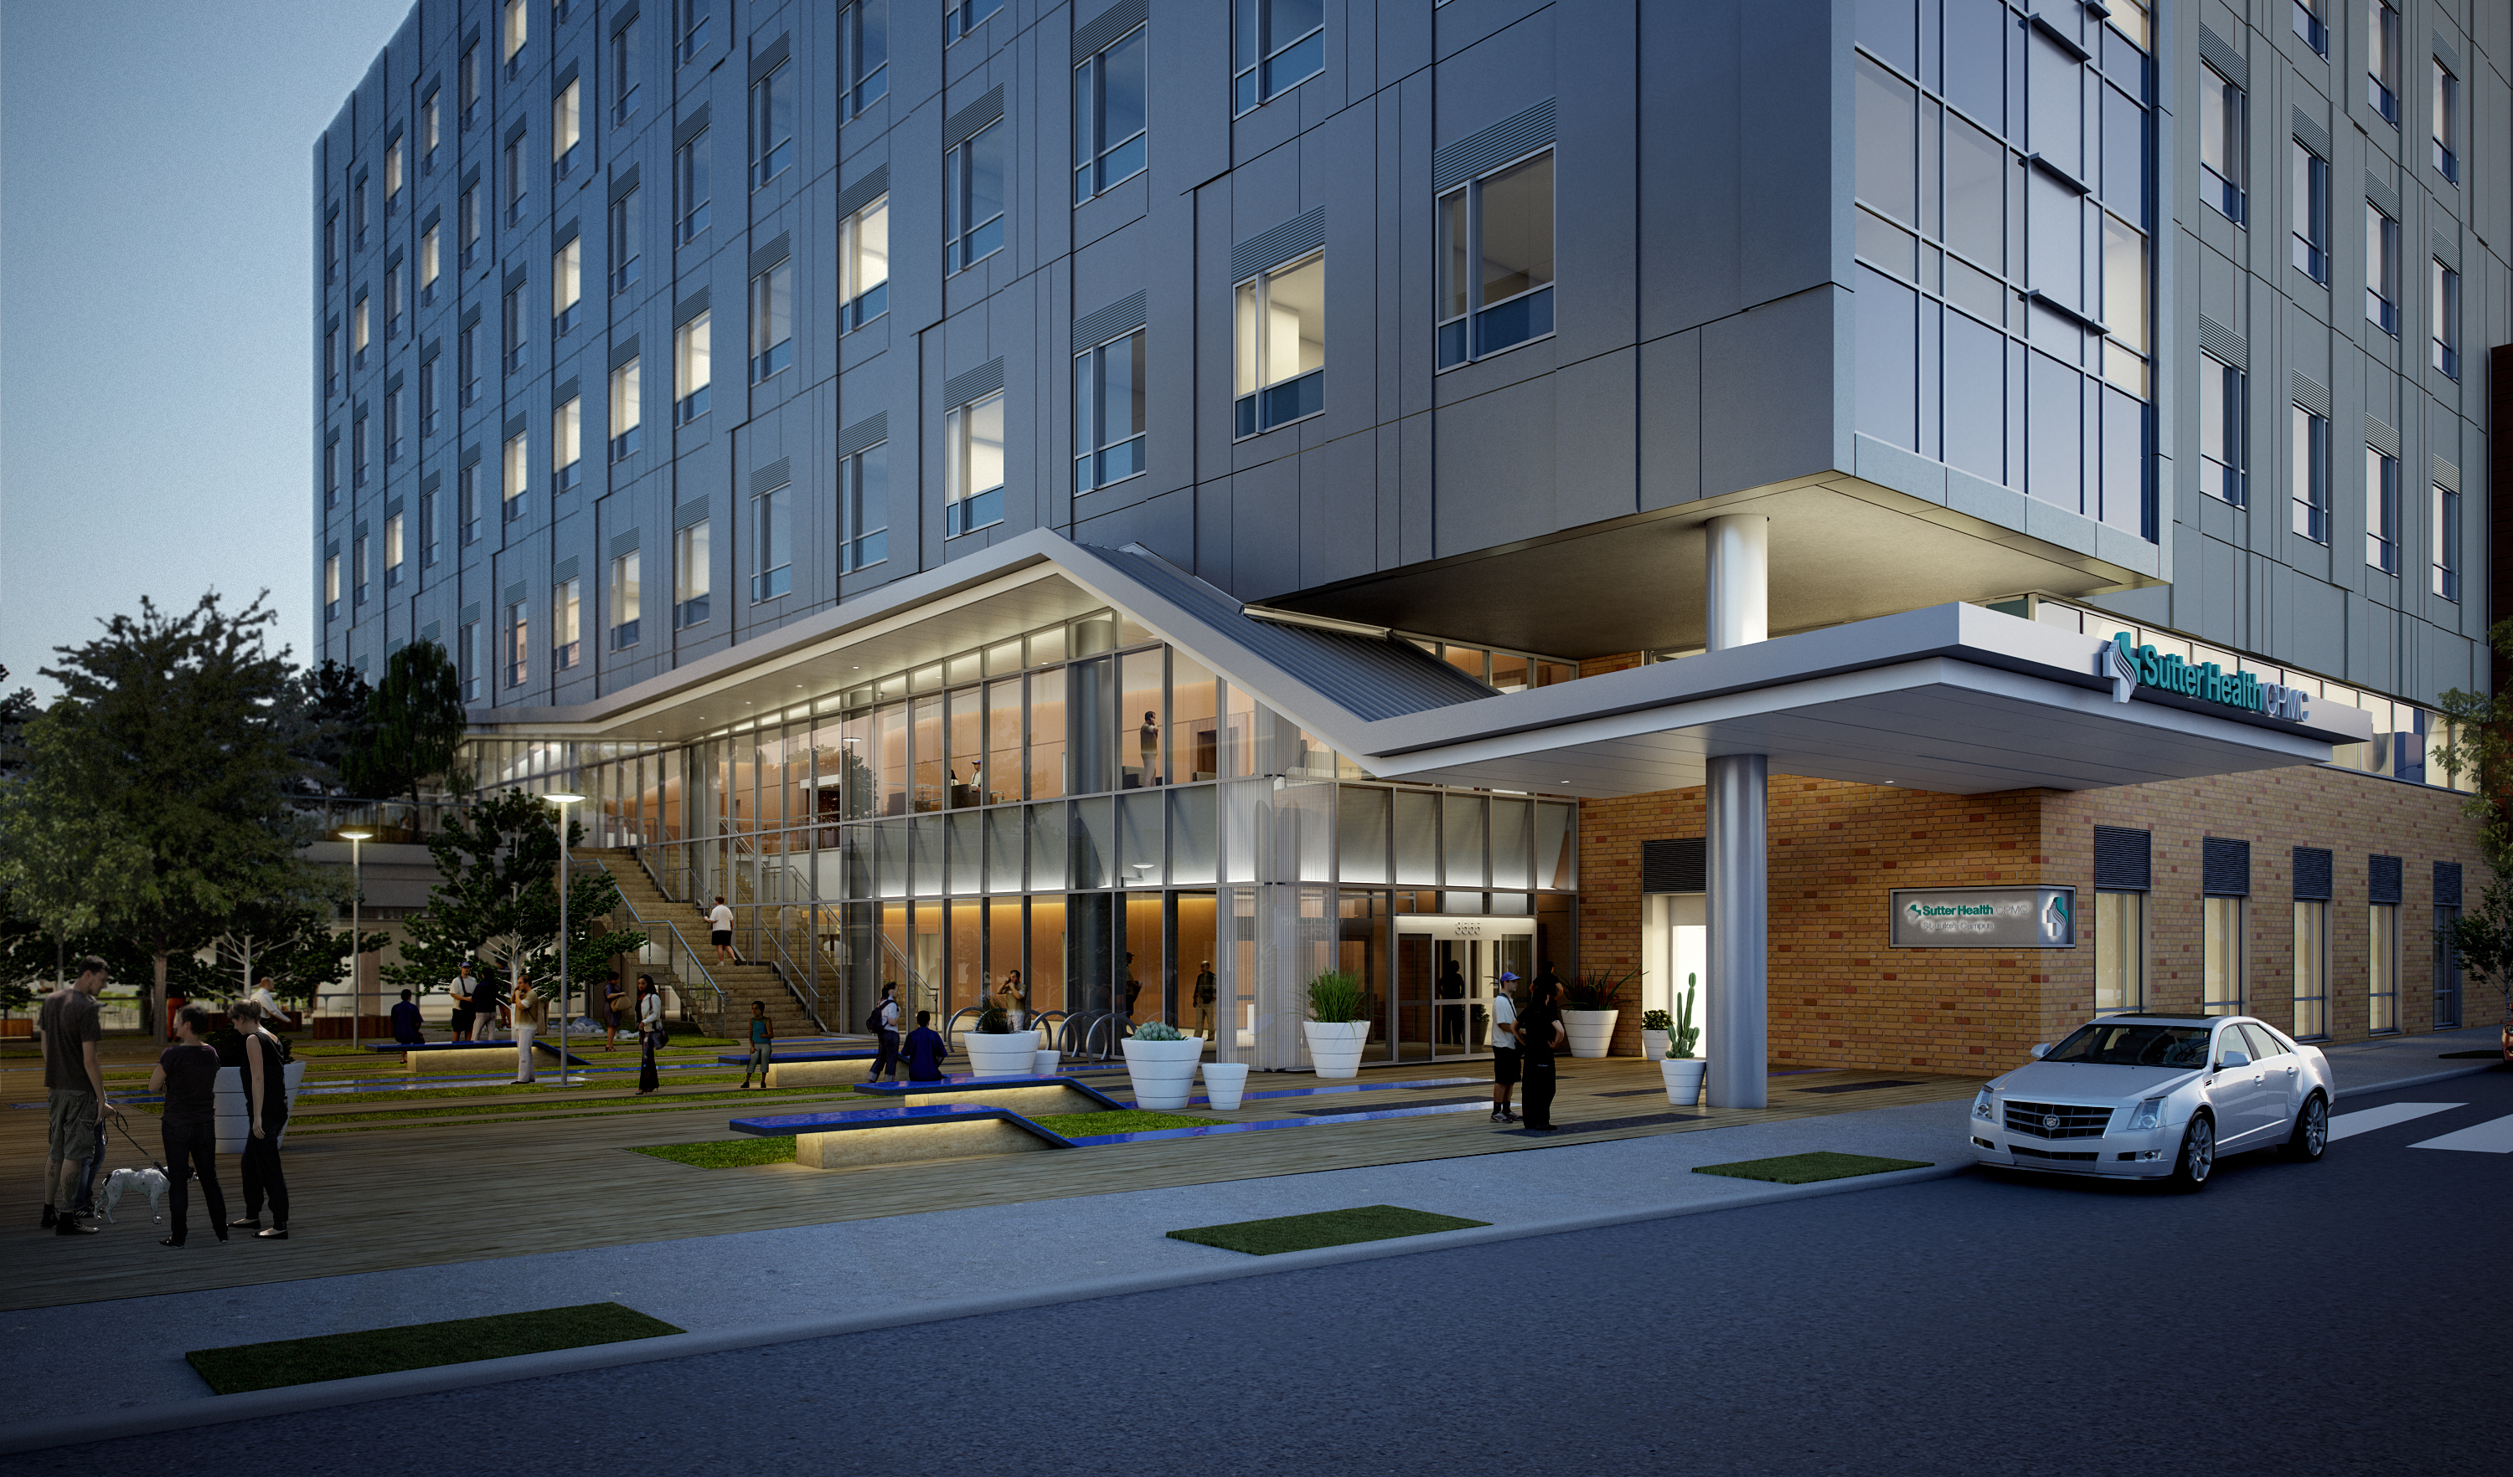
Mission Bernal Sevice Locations
Notes:
It’s getting very real—escalation of activity leading up to August 25 patient move
We’re One CPMC, and the transition to both new hospitals will touch all of us
(Plus some of you at Pac or Cal may be moving to Mission Bernal or vice-versa??)
(ST Lukes) – ??? Days to Aug 25th Opening.

Slide 14
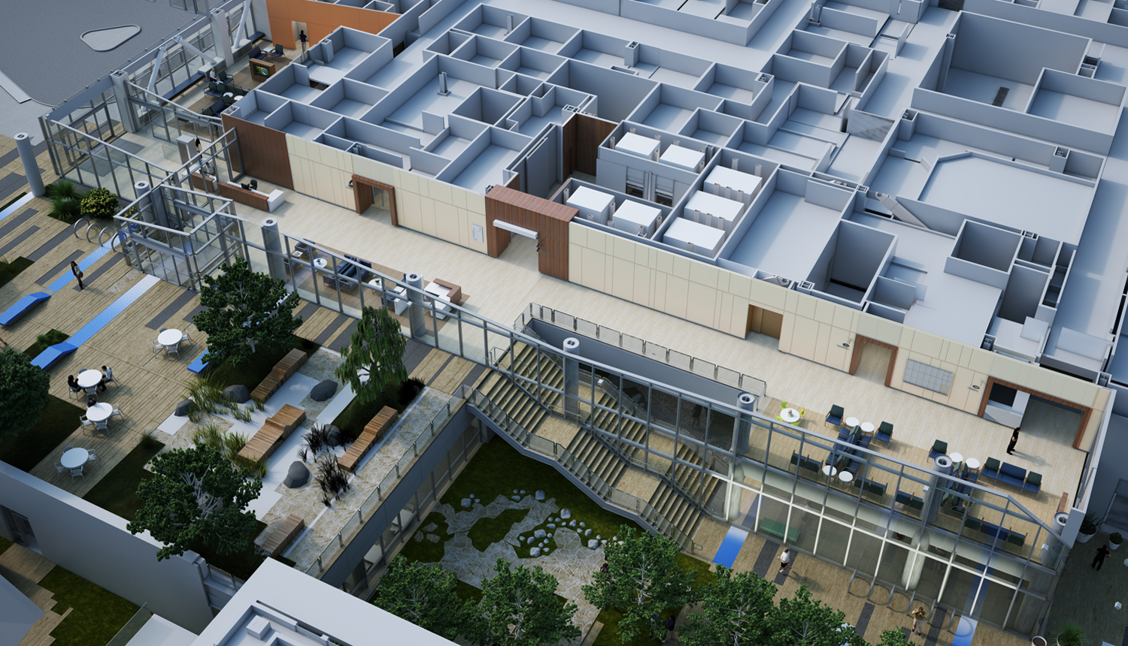
Mission Bernal Sevice Locations
Notes:
It’s getting very real—escalation of activity leading up to August 25 patient move
We’re One CPMC, and the transition to both new hospitals will touch all of us
(Plus some of you at Pac or Cal may be moving to Mission Bernal or vice-versa??)
(ST Lukes) – ??? Days to Aug 25th Opening.

Slide 15
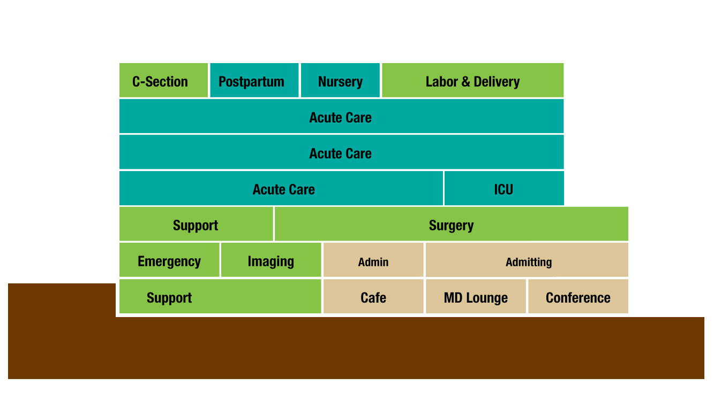
27th Street
Cesar
Chavez
Go to CPMC2020.org for Virtual Reality Views of Departments

Slide 16
Mission Bernal: Services I
Medical Services
Critical Care
General Medicine
Geriatrics
Medical Sub-Specialties
Surgical Services
ENT
General & Vascular Surgery
Gynecology
Ophthalmology
Orthopedics
Urology
Obstetrics
Notes:
For STL – Most of you will move right next door.

Slide 17
Mission Bernal: Services II
Additional Patient Services
Emergency
Antepartum Testing
Breast Health
Cardiac Rehab
Chapel
Diabetes Center
Non-Invasive Cardiology
Lab/Pathology
Newborn Connections
Pulmonary Function Lab
Pulmonary Rehab
Specialty Clinic & HCC
Radiology
Support/Admin Services
Admin
Care Coordination
Clinical Research
Engineering
EVS Offices
Info Services
Interpreter Services
Pharmacy
Scheduling
Volunteer Office
Notes:
For STL – Most of you will move right next door.

Slide 18
Mission Bernal Auxiliary Buildings: I
Remain at 1912 Valencia
Breast Health
Chapel
Diabetes Center
EVS Offices
Remain at Monteagle / 1580 Valencia
Radiology
Lab Draw
MD Offices
Pharmacy
Specialty Clinics & HCC
Notes:
STL ONLY

Slide 19
Mission Bernal Auxiliary Buildings: II
Moving to 1912 Valencia
Admin
Care Coordination
MB Scheduling
Volunteer Office
Moving to Monteagle / 1580 Valencia
Engineering
Info Services
Interpreter Services
Newborn Connections Non-Invasive Cardiology
Moving to Hartzell Building (in 2019)
Admin
Antepartum Testing
Cardiac Rehab
Clinical Research
Engineering
Pulmonary Function Lab
Pulmonary Rehab
Notes:
STL ONLY

Slide 20
Hey. No peeking
Notes:
It’s getting very real—escalation of activity leading up to August 25 patient move
We’re One CPMC, and the transition to both new hospitals will touch all of us
(Plus some of you at Pac or Cal may be moving to Mission Bernal or vice-versa??)
(ST Lukes) – ??? Days to Aug 25th Opening.

Slide 21
Welcome Video Place holder

Slide 22
Care
Performance
Me
Community
Notes:
^{Importance of measuring} ^{how we are doing}
^{Investment in becoming a} ^{highly reliable organization}
^{Share, learn, reward}

Slide 23

Care
Performance
Me
Community
Handwashing is one of our three high reliability initiatives
full performance
85% compliance
threshold performance
75% compliance

Slide 24
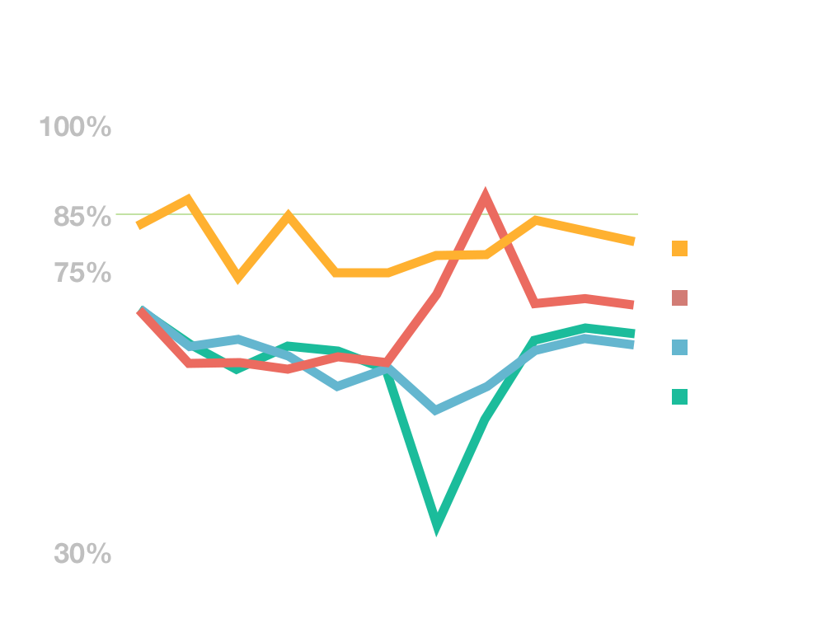
Handwashing
All CPMC Campuses
Congrats!
Best Results to Date

Slide 25
Employee Handwashing
average September 2017
St. Luke’s – SNF leads the way
SNF
ICU
Sub Acute
MedSurg 9th Fl
Telemetry 10th Fl
93%
90%
88%
84%
81%
Below Threshold
Threshold
Full

Slide 26

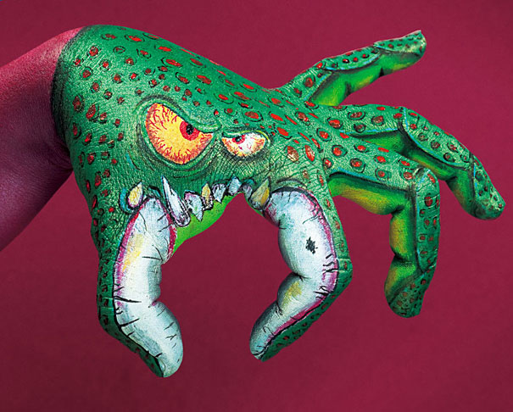

What can we do to continue our progress?
Notes:
Reference AeroScout

Slide 27

Financial Health
Affordability (n.)– within the financial means of most people… reasonable… accessible
How are we doing?
Notes:
What does affordability mean?
To Sutter Health
To CPMC
To our patients
Increasing Costs of Care, Co-pays, Insurance Premiums

Slide 28
Our Costs compared to Northern CA
Median CPMC

Slide 29
Cost of healthcare in the US
Median CPMC
Source: CMS.HHS.gov
Notes:
SOURCE : Centers for Medicare and Medicaid Services, Office of the Actuary, National Health Statistics Group
http://www.kff.org/report-section/health-care-costs-a-primer-2012-report/

Slide 30
Bending the Affordability Curve
Cost of Care
Think globally, but act locally.
Time

Slide 31
…and now for something lighter.
Notes:
Our affordability challenge. Let it sink in.
But now lets move to something lighter.

Slide 32
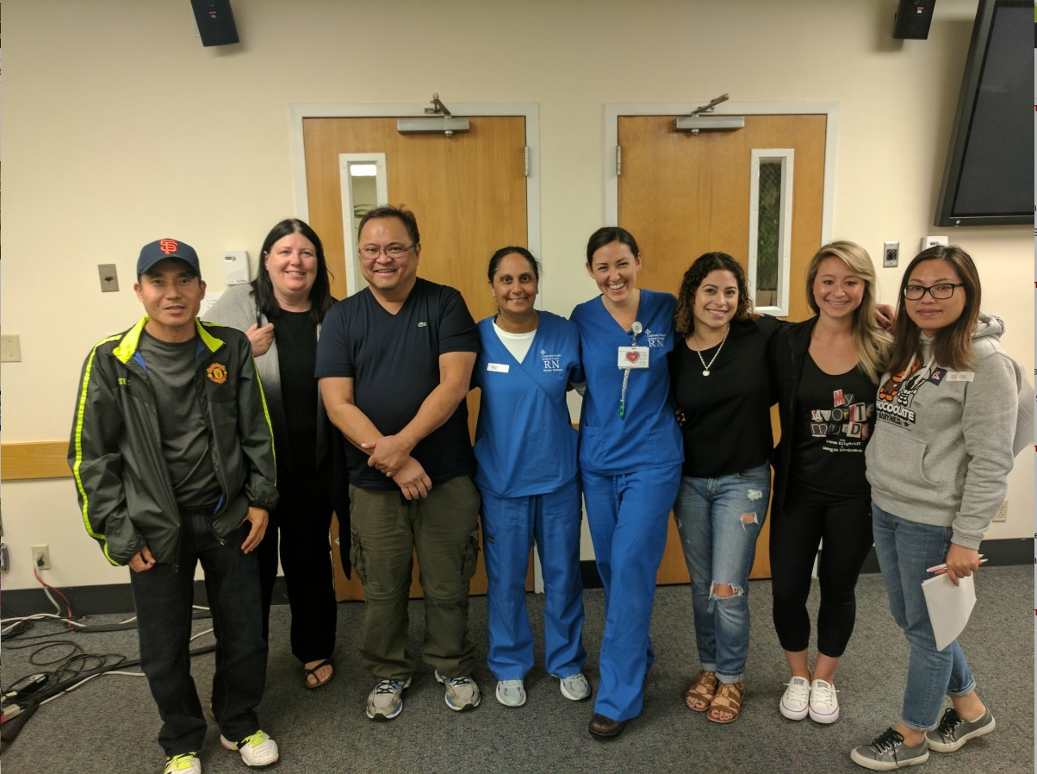
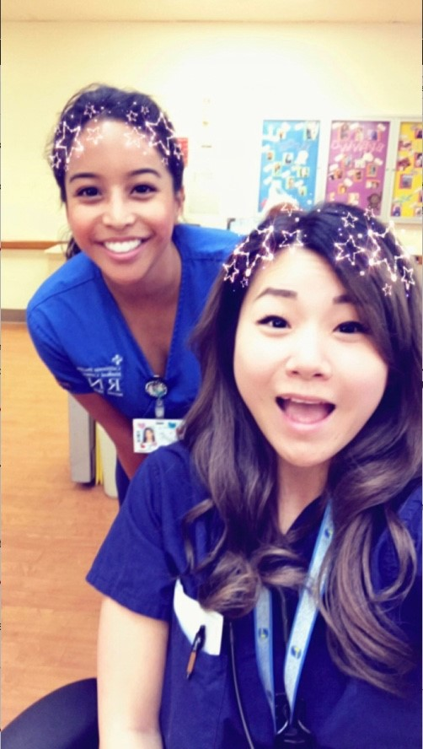
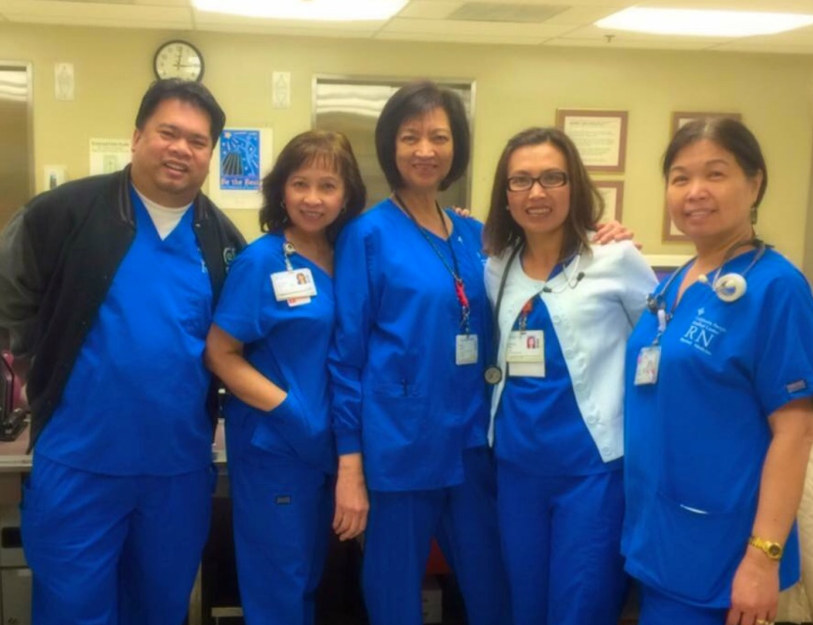
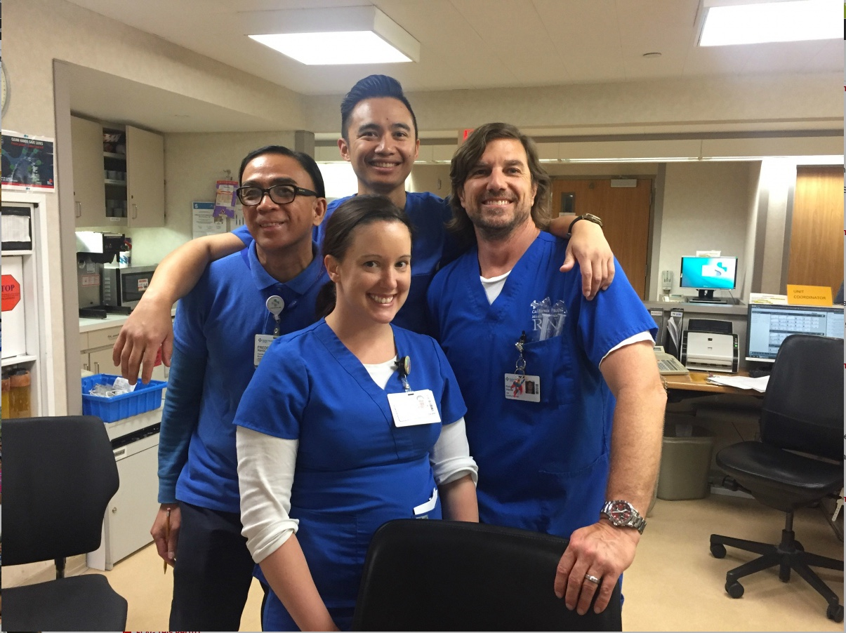
Care
Performance
Me
Community
Notes:
We are each an important and critical part of CPMC
A complex organization
Responsible to ourselves and our team for doing our best
Personal accountability

Slide 33
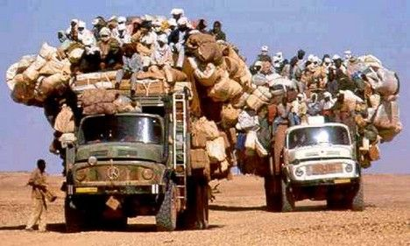
Your #1 (and #2) questions about the new hospitals:
How will I
get to work?
Where will I park?

Slide 34
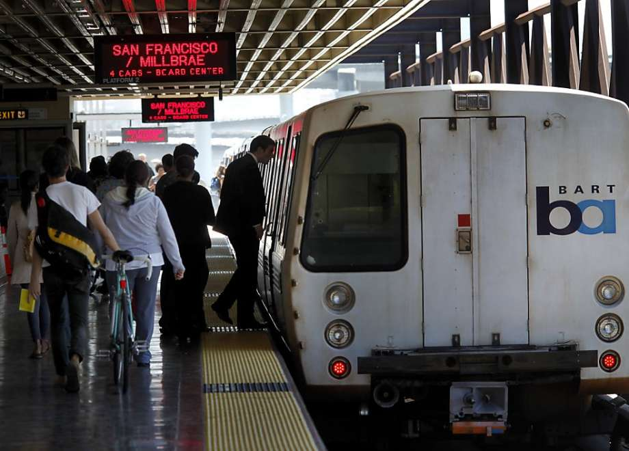

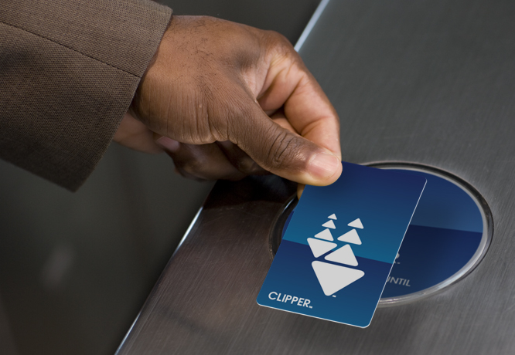
Our commitment to the City
Reduce the number of cars
Public transportation
Bike parking
Shuttles
Car pooling
Subsidies

Slide 35

How’s it looking now?
Employee Carpools
Cal: 20
Pac: 5
Davies: 4
SLH: 1
Notes:
August 2017 data
Carpool graphic

Slide 36
Notes:
Includes Clipper Cards

Slide 37

What can you do right now?
Start using van pools
Use public transportation
Go online to: www.wework.org (for subsidies)

Slide 38
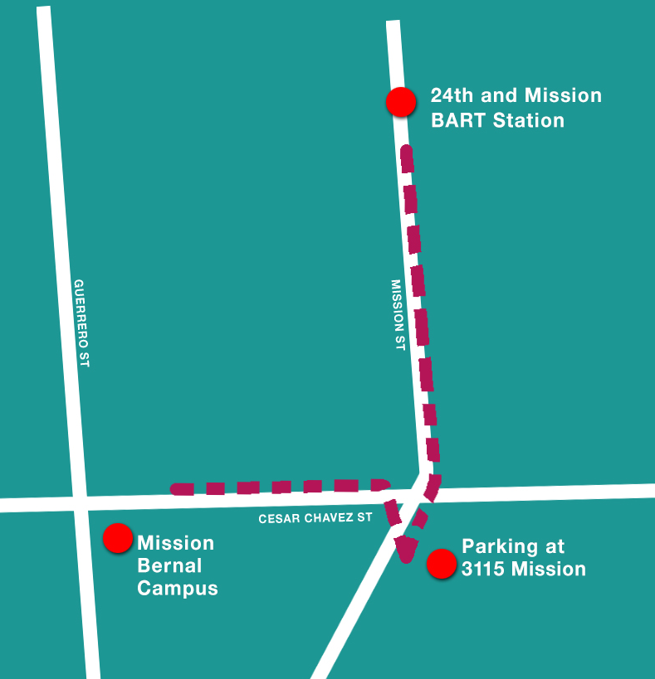
Starting Feb 2018: New Shuttle Mission Bernal to and from 24th St. BART
Every 30 minutes
6am – 6pm
Also picks up from off-campus parking lot at 3115 Mission St.
Notes:
Just for St Lukes Town Hall

Slide 39
Where will I park?
Existing campus garage
including evening and night shift
New: 3115 Mission St. (Construction Site Parking Lot)
60 spaces
4 minute walk from campus
Business Hours Only (for safety)
Notes:
Only for St. Lukes Town Hall

Slide 40


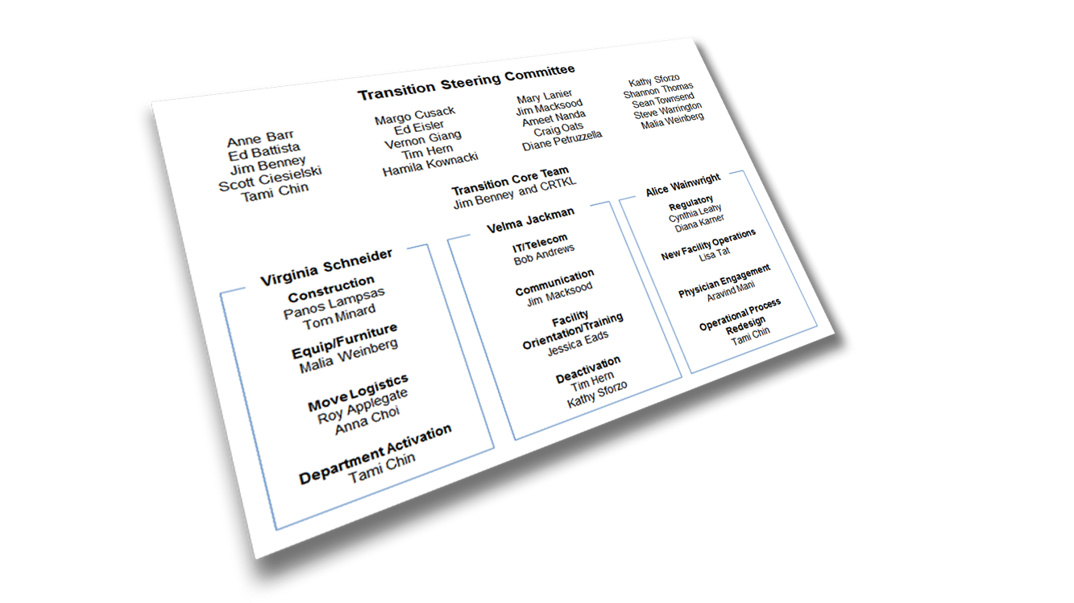
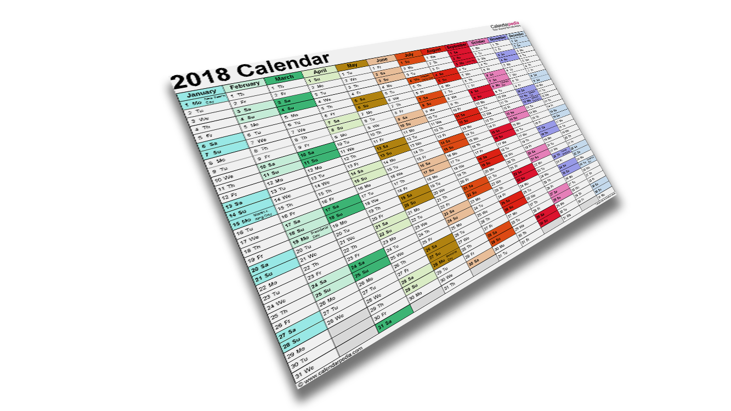
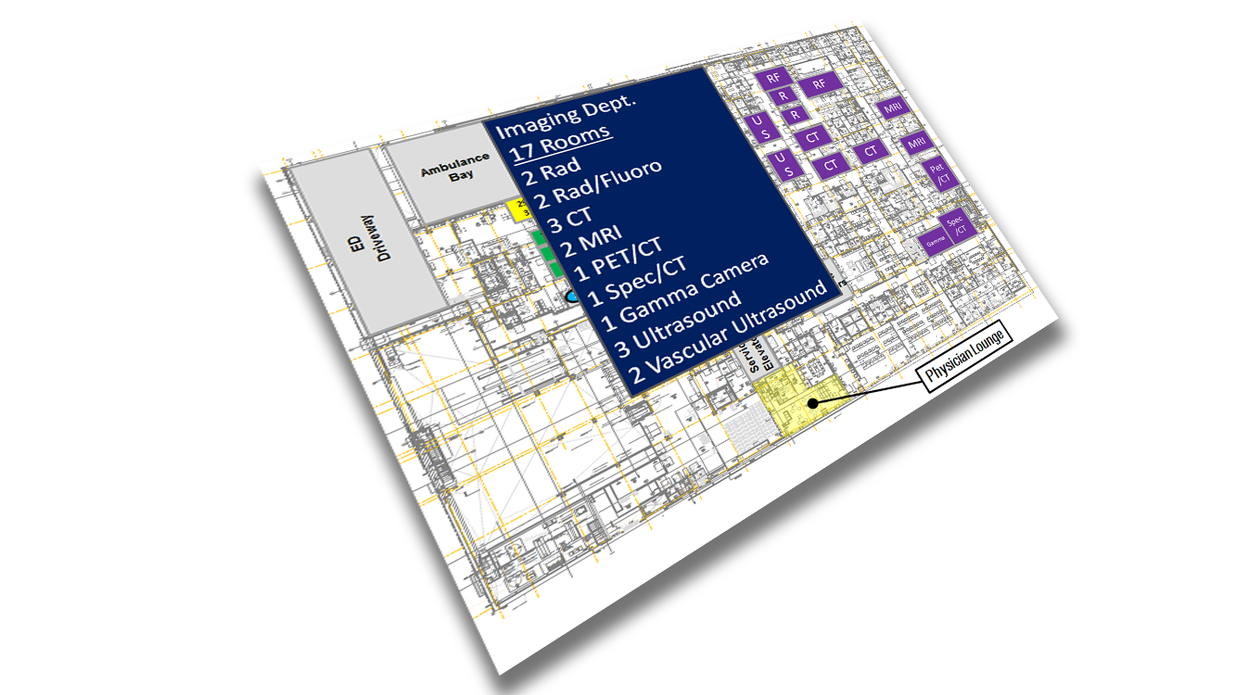

The transition is
complicated.
Notes:
These hospital moves are complicated.
Imagine, moving hundreds of pieces of equipment, getting the supplies stocked, orienting everyone to the new buildings, and then moving staff and patients – all without interruption in patient care
Our primary responsibility is to make sure the moves are as smooth as possible and that we are ready to go.
So, we’re not cramming it all in over a short period of time, but being very thoughtful and systematic

Slide 41
Just to give you an idea…
1,575
milestones
238
action items
(and counting)
332
900
existing technical applications to install
budget line items
90
new applications to install

Slide 42
Transition Steering Committee
Anne Barr
Ed Battista
Jim Benney
Scott Ciesielski
Tami Chin
Margo Cusack
Ed Eisler
Vernon Giang
Tim Hern
Hamila Kownacki
Mary Lanier
Jim Macksood
Ameet Nanda
Craig Oats
Diane Petruzzella
Kathy Sforzo
Shannon Thomas
Sean Townsend
Steve Warrington
Malia Weinberg
Transition Core Team
Jim Benney and consulting firm
Virginia Schneider
Velma Jackman
Alice Wainwright
Construction
Panos Lampsas
Tom Minard
IT/Telecom
Bob Andrews
Regulatory
Cynthia Leahy
Diana Karner
Communication
Jim Macksood
New Facility Operations
Lisa Tat
Equip/Furniture
Malia Weinberg
Facility Orientation/Training
Jessica Eads
Move Logistics
Roy Applegate
Anna Choi
Physician Engagement
Aravind Mani
Department Activation
Tami Chin
Deactivation
Tim Hern
Kathy Sforzo
Operational Process Redesign
Tami Chin
Notes:
So, how are we making all of this happen?
12 different Focus Groups that have been meeting at least monthly
Focus group leaders are meeting together 2x/mth to share and collaborate
Plus, an overall Steering Committee to make sure all on target

Slide 43

Mission Bernal Transition Schedule
Completed — Spring 2017
Occupancy planning meetings with departments (40)
Support Departments planning meetings (14)
Notes:
Here’s what we’re looking at for the M-B move and training schedule
There will be training for everyone who is moving to one of the new hospitals on entrances, badging, elevators, safety, lockers and other employee services
Also, clinical training – in unit, work with lifts, other technologies
And department-specific training
We don’t yet have exact dates, but will keep you posted.
So, stay tuned!

Slide 44
Mission Bernal Transition Schedule
Now – End of 2017
Medical equipment and signage validation
Move Logistics meetings with departments (28)
Begin Clinical and Move Day meetings with departments
Art selection
All hospital processes re-design completed (Dec.)

Slide 45






Mission Bernal Transition Schedule
2018
May
Install equipment, electronics & furniture
June
Clinical and Move Day meetings completed (52) Project Team turns building over
June – August
Staff and Stock
Includes general hospital/clinical training (est. 8 hour each) & department-specific (est 8–40 hours)

Slide 46
Transition Timeline
PTO Reminder: All Campuses
2017
2018
2019
2020
For Pac/Cal Move Mar. 2019
For St. Luke’s Move August 2018
For Pac/Cal Move Nov. 2018—Mar. 2019
For St. Luke’s Move June—August 2018
MB
STL
PAC
Some Departments will need VP approval for PTO:
2 weeks before move, these groups also need VP approval
VN
CAL
Parking Services
Residents
GME Office
Human Resources
OP Clinics
Diabetes Center
Infusion Services
Radiation Oncology
EEG / Neurosciences
Quality/Infection Control
Risk Management
Interpreter Services
Research
Pastoral Care
IHH
IP Nursing (inc. NPs, CNS, Educators)
Care Coordination
CCL/IR/EP/GI/IES
Surgical Services
Respiratory Therapy/Pulmonary
Pharmacy
Lab/Pathology
Diagnostic Imaging
Cardiology
PT/OT/SP
Food & Nutrition Services
EVS
Transport
Supply Chain
Plant Operations
Biomedical Engineering
Security
Safety
IT and PBX
Patient Access
Newborn Connection
VN MOB
PAC O/P
PAC
CAL O/P
MB
DAV
Notes:
Remember this slide. I want to call your attention to these little chunks of time.
Usual practice, scheduled PTO requires approval from your manager.
For the St. Luke’s move, approvals must be given by your VP, so talk to your manager.
This is for all campuses not just St. Luke’s
Why?
Its about having a safe move
We need to make sure we do not have “10 people out at the same time”
Some staff from other campuses will take on work at St. Luke’s while the St. Luke’s staff are moving.

Slide 47
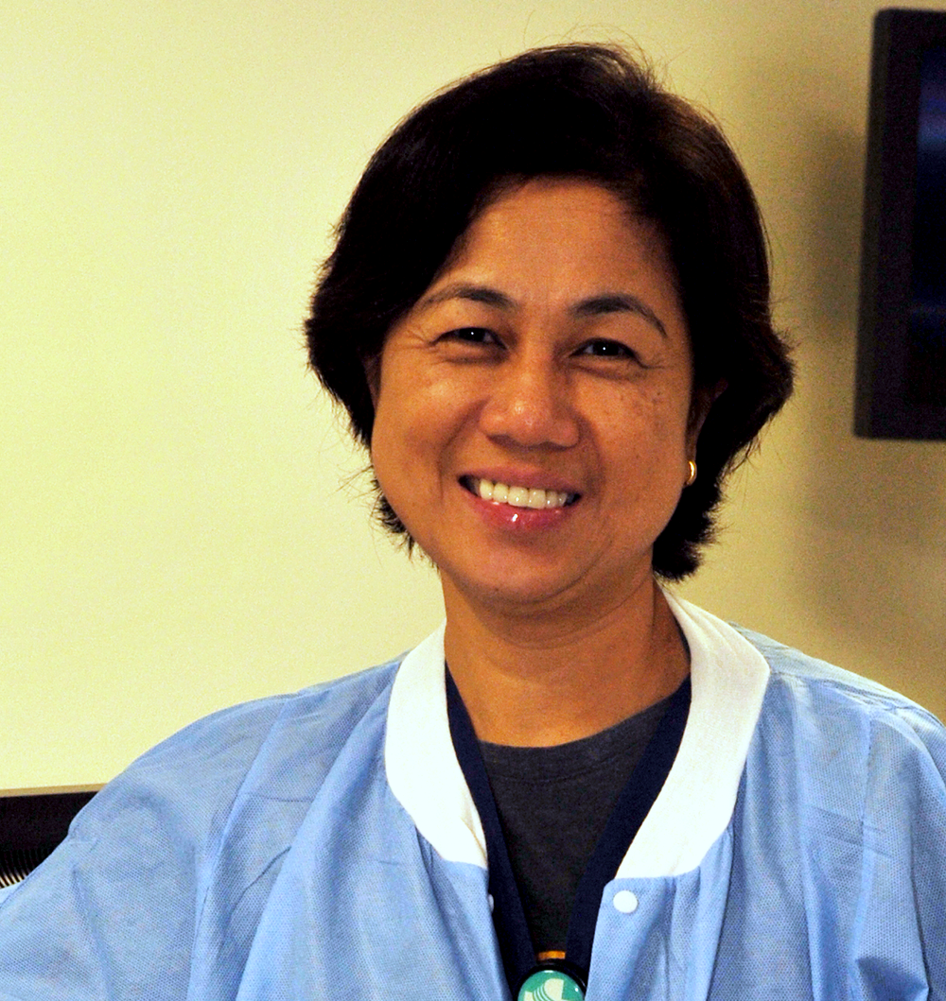
Dawit Asmelash
And now let’s take a moment to recognize one of our star employees…
And now, we want to take this time to recognize one of our own…
G.I. Tech
Pac Campus
Notes:
PAC
Dawit Asmelash is a simply outstanding G.I. tech working in IES. His work is consistently excellent, but more than that he exhibits every positive behavior one could hope for in a coworker. The G.I. tech group as a whole is excellent and certainly hard-working, however we did experience a once in 14 year occurrence in January where not one, but two G.I. techs were on a leave at the same time due to circumstances beyond their control. This naturally coincided with an uptick in volume at all locations leaving us woefully short of qualified G.I. techs to maintain the instruments. I frankly did not have a good solution, and shared as much with the team. It required one tech to stay late and cross campuses to complete the work so that each unit would be prepared for the next day. Dawit Asmelash spoke up and volunteered that since it needed to be done, he would do so in the interest of our patients and keeping our units running. Anyone who knows Dawit is aware that he is a soft spoken gentleman and the kindest of souls, but regarding this critical operational issue he was adamant about the work getting completed to the highest standard. He stayed not one night, not two, not three, but for a week and a half without a single complaint, additional request, or excuse. He just got it done, into each night with elegance and grace. I am very proud to be working with a gentleman of this caliber and we are a stronger and more cohesive team with his teamwork and quiet leadership. We are very grateful to Dawit.

Slide 48
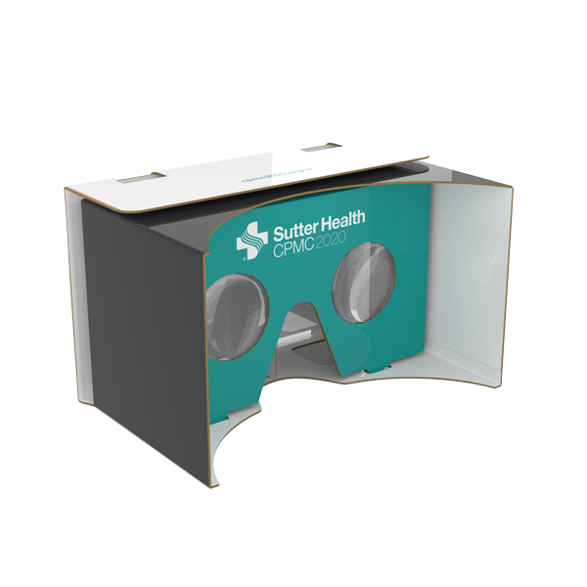
Reminder
Look for new VR Photos on the intranet
Submit your stories and photos for the Transition Keepsake

Slide 49


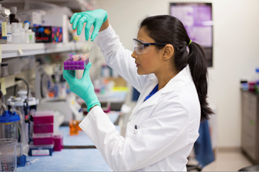
Our investment in the community
Care
Performance
Community
Care
Performance
Me
Community

Slide 50
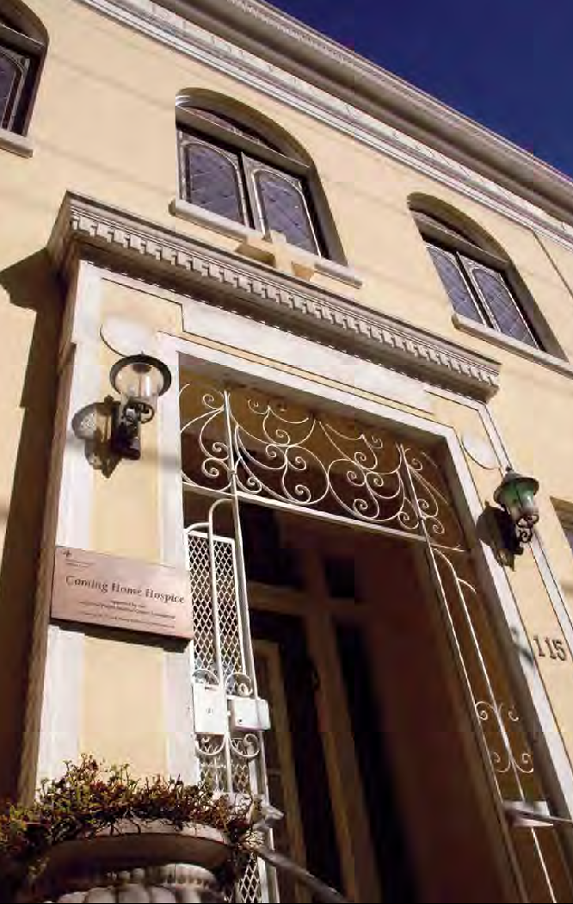
Coming Home Hospice
A 15-bed residential hospice located in the Castro district
Began as an AIDS hospice
Has provided end-of-life care to about 3,500 people since 1987
A part of CPMC since its beginning
CPMC Foundation partners with Coming Home Hospice to raise funds so all patients can access services, regardless of ability to pay
Notes:
As one of CPMC’s Community Benefit programs, this is one of the contributions we make to the communities we serve, as part of our non-profit, tax-exempt status.
End-of-life care is an important part of what we do – throughout CPMC – and that we can and do make it easier for families
Began as an AIDS hospice – first of its kind in the US
The hospice is a department of CPMC; CPMC developed the hospice in collaboration with the AIDS patient advocacy community and the Catholic Church, which donated the use of a former convent
Over half of patients are on a sliding fee scale, and we work with our partners to offer additional financial assistance
CPMCF’s support is critical to the hospice’s sustainability – makes up the difference between cost of care and what patients can pay
Between CPMC Foundation and CPMC Operations, we contribute just over a million dollars each year to provide this vital service to our community

Slide 51
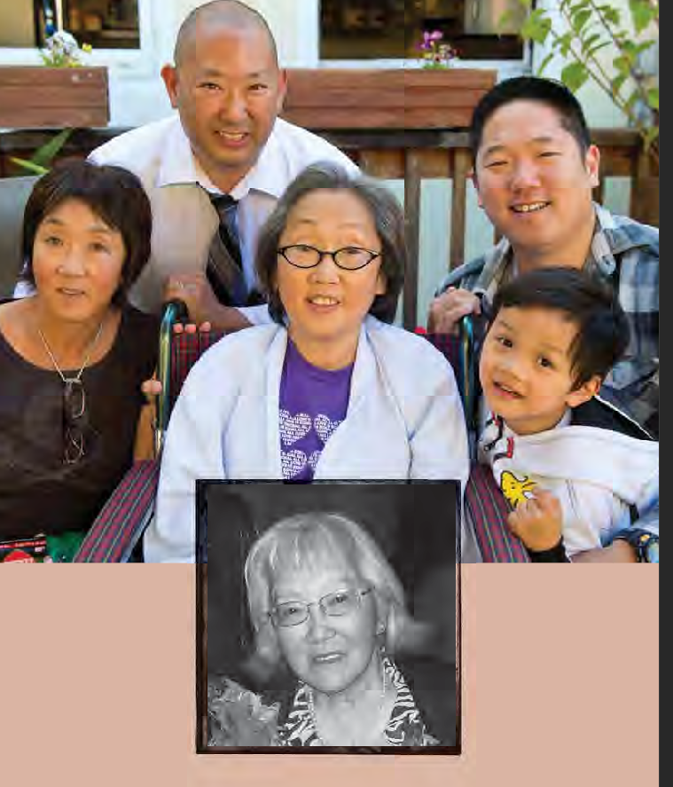
The Nakanishi Family’s Story
“The care here is genuine, really from the heart. We are amazed there is still a place like this in today’s world.”
Rod & Stuart Nakanishi, sons and brothers
Notes:
(to be read while slide is up Print separate Large)
Coming Home Hospice played an important role in the Nakanishi Family.
First, their mother became a patient.
When their mother Sachiko was a patient there, her daughter Cynthia learned that she had her own late stage cancer and said, “I am going to live my last days at Coming Home.” Cynthia is the woman in the photo in a wheelchair.
Here is what Rod and Stuart, Sachiko’s sons and Cynthia’s brothers, said about Coming Home Hospice:
“This is not a fancy place. What struck us after a thorough search for care providers for our mother – and now our sister – is that the care here is genuine, really from the heart. This is what is most important to us.
“It is also a place that allows us to process all the emotions of grief – denial, depression, anger, sadness. Nothing is left unsaid.
“Coming Home Hospice is a jewel in the city for this kind of care. To work here, one must have an appreciation, an enjoyment, of life. Like when we were born – natural and loving to everything. The people here still have those qualities – goodness, sincerity, and a giving attitude.
“We are amazed there is still a place like this in today’s world. They help make the last days enjoyable, for the patients and their families.”
Rod is now a volunteer at Coming Home Hospice.

Slide 52


Questions?

Slide 53
Drawings! Evaluation Form …and thank you!

